Slide 1

SAP Build Training for Corporate Professionals
DAY-21
www.anubhavtrainings.com

Slide 2


DISCLAIMER
The training content and delivery of this presentation is confidential, and cannot be recorded, or copied and distributed to any third party, without the written consent of Anubhav Trainings

Slide 3
Agenda
SAP Build Transport
SAP CI CD Service
TMS Service
Content Transport

Slide 4

Use case
Persona:
Name: Priya
Age: 32
Role: A health-conscious mother of a 6-year-old boy
Goal: To ensure her son eats healthy snacks, avoiding high sugar, additives, or allergens
Scenario:
Priya is grocery shopping on a busy weekday afternoon. Her son loves trying new snacks, but Priya is always worried about hidden sugars, preservatives, and allergy-triggering ingredients. Reading tiny labels on packaging is time-consuming and frustrating.
Key Features of the App:
- Barcode scanning
- Instant nutrition info from Open Food Facts
- Allergen warnings
- Healthy alternatives
- Kid-focused nutritional grading
Benefit:
Priya saves time and makes informed decisions, ensuring her son enjoys tasty snacks without compromising health.

Slide 5
Build Apps - Builder area
When working with SAP Build Apps, the majority of your time will be spent in the app builder area. This area allows you to complete key tasks such as, but not limited to, the following:
Build pixel-perfect user interfaces
Integrate with external data resources
Create complex logic with visual programming
Bind data to components to create dynamic views
Define navigation
https://help.sap.com/docs/BUILD_APPS/431746e4c663458aa68d9754b237bfc6/daece9f87abf4f7187a14ae0b1f8b2ab.html

Slide 6
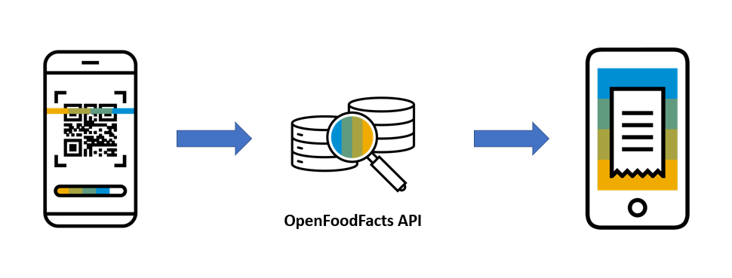
Logic Flows
Logic flows are used to capture events in an application, such as a page loading or a user tapping on a button, and to execute actions – for example, to change the value of data or to open the device’s camera.
To create a barcode scanning app, you need to configure a logic flow that tells your application to open the camera device once the user taps the Scan button. To do this, we’ll show you how to add the logic to the button, then how to take advantage of SAP Build Apps’s QR and Barcode component.
In the logic panel, you can see the Event - Component Tap, which is triggered when a user taps on the button. We now need to decide what this event will do.

Slide 7
What is JSON – Java Script Object Notation
{
key: ‘value’,
key: ‘value’,
key: ‘value’
}
orderNo shipTo date
101 | SHIP1 | 20251212

Slide 8
Open APIs
Open Food Facts offers a comprehensive API that allows developers to access a vast database of food product information, including details such as ingredients, nutritional content, allergens, and labels. This open-source database is continually enriched by contributors worldwide, making it an invaluable resource for applications focused on health, diet tracking, food research, and consumer information. citeturn0search0
Key Features of the Open Food Facts API:
- Extensive Data Access: Retrieve detailed information about food products, including ingredients, nutritional facts, allergens, and more.
- Global Coverage: Access data from a wide range of products sourced from various countries, providing a diverse and comprehensive dataset.
- User Contributions: Benefit from a continually growing database, as users worldwide contribute by adding new products and updating existing information.
- Integration Flexibility: Utilize the RESTful API to seamlessly integrate food product data into mobile apps, research projects, software, or diet-based web services.
https://world.openfoodfacts.net/api/0/product/8904004400083?fields=product_name,nutriments,image_front_url
Sample products –
8901764061257
8901262200189
8901063029279
8904004400083

Slide 9
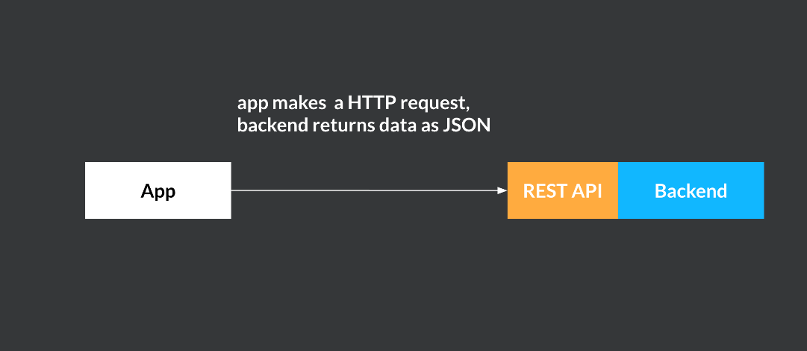
Build Apps – REST API integration
SAP Build Apps enables you to create applications on multiple platforms such as iOS, Android, and Web. Most apps need some way to store data when the app isn't running. The data can be stored on the device itself or in an external back end, accessible over the Internet. A common architecture for Internet services is a front end - back end model, in which an app acts as the front end handling user interactions, while a back end stores and processes data. As it's typical that a front end (or multiple front ends) will use a different technology stack from that of the back end, there needs to be an easy standard way to communicate between the two.

Slide 10
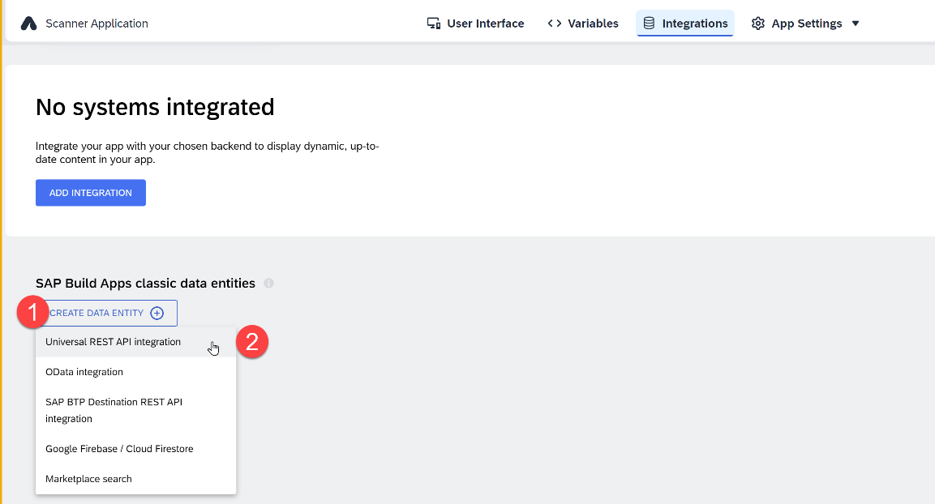
Integrations – REST API
A REST API direct integration type data resource essentially tells SAP Build Apps how a specific, JSON-format HTTP REST API can be accessed. It defines things like a base URL, headers, query parameters, available methods, schemas, and so on. You can create new external data resources and edit existing ones via the Data button in the top toolbar. The resource configuration is split into base configuration and method configurations for GET collection, GET record, POST, PUT/PATCH, and DELETE.

Slide 11
Parts
https://world.openfoodfacts.net/api/0/product/8901063029279?fields=product_name,nutriments,image_front_url

Slide 12
Types of Dynamic variables
Dynamic variables are the backbone of your app logic. For the most part, the data they contain at any given time is determined by what flow functions have been called during the app runtime so far.
Page variables
Page variables exist in the context of a single page. When a page is removed from the navigation stack, its page variables are reset.
Data variables
Data variables are like page variables, but their schema is defined by the data resource they are linked to. They also come with default logic that loads the associated data from the backend and stores it in the data variable.
App variables
App variables exist in the global context of the app. When the app opens for the first time, or is closed and reopened, app variables are reset.
Page Parameters
Page parameters can only be of the text type. Page parameters are read-only variables that can be set with the Open page flow function for the new page, e.g. ID of a product for a product details page.
Theme variables
Theme variables define how the various view components look, giving you an easy way to change the whole look-and-feel of your app.
System variables
System variables define properties of the current app and the device its running on. They cannot be affected by the user directly, but change when the underlying property changes.

Slide 13
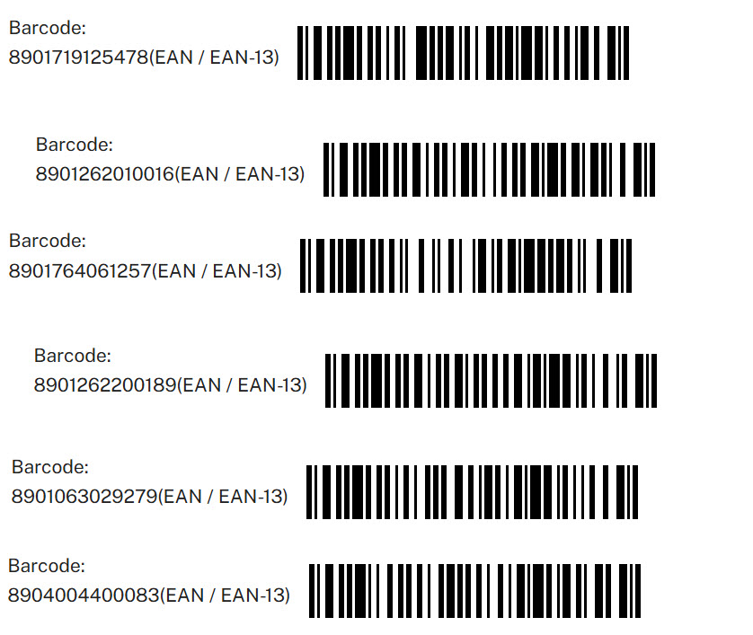

Test data

Slide 14

What We Did
Let’s Summarize
www.anubhavtrainings.com

Slide 15
www.anubhavtrainings.com
Thank You
End of Day 21
www.anubhavtrainings.com

Slide 16


We’re committed to empower you to be
#FutureReady
through powerful training solutions.
We build the workforce of the future.
250+
Corporate Clients
30,000+
Learners Trained
25000+
Learners Placed
FREE WEBINARS
Sign up for free webinars with industry experts every fortnight!
Enroll Now!
Contact us today!
https://anubhavtrainings.com

